Slide 1
Bar Soap (Chemical Reaction) Product Defect Minimization & Production Process Optimization

Slide 2

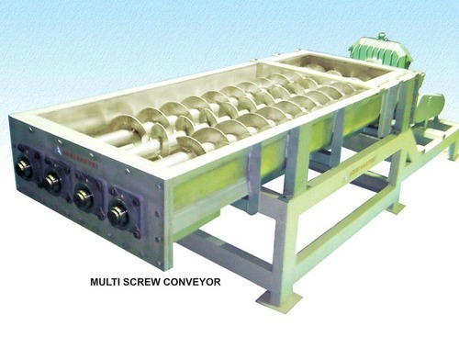
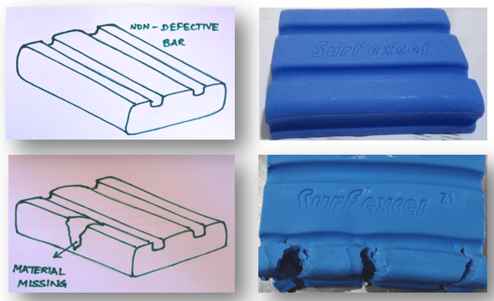
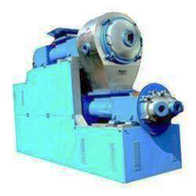
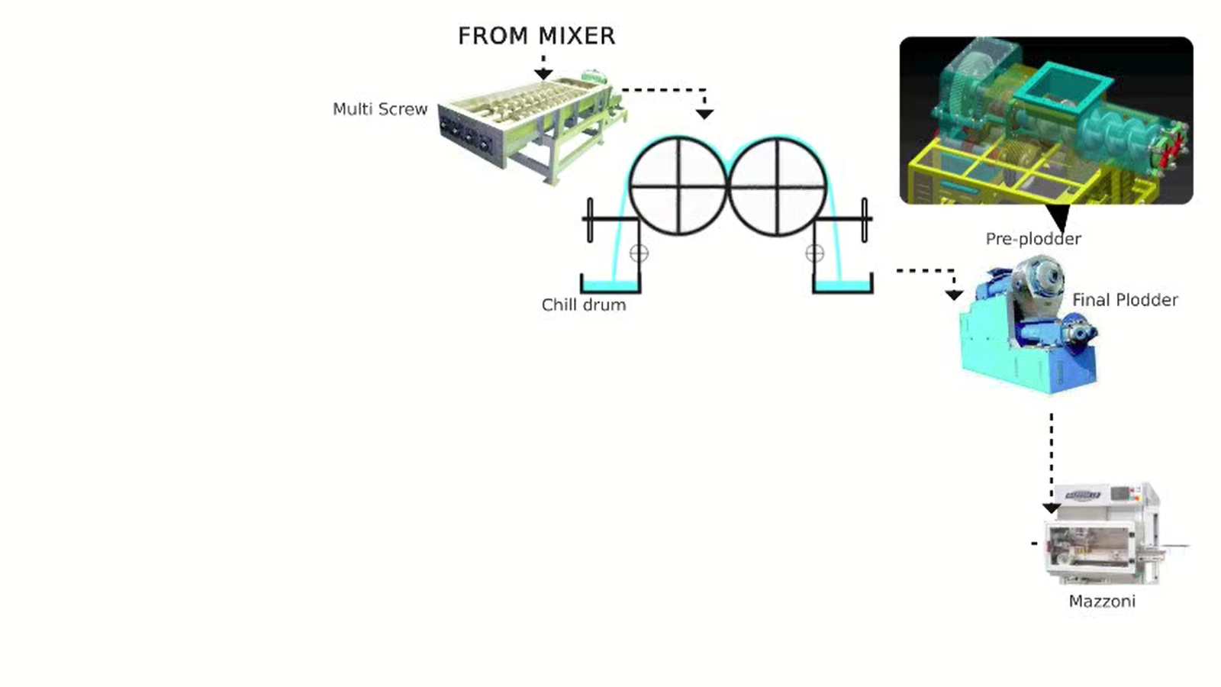
Variables Influencing Quality of Quality of Bar Soap Products
Batch making process
Batch RM input
Motor & Gear box
LIQUID RM QUALITY PARAMETERS
SOLID RM QUALITY PARAMETERS
RM DOSING QUANTITY
RM DOSING TIME
BATCH START TIME
BATCH STOP TIME
SODAL DAY TANK TEMP
DOSING TEMP
SPEED
CURRENT
VIBRATION
TEMPERATURE
Output parameters
PENETRATION VALUE (PV)
ACTIVE DETERGENT (AD)
TABLET TEMPERATURE
GRIT
WHITE PATCHES & BAR CRACKING
Mixer
Motor & Gear box
SPEED
CURRENT
VIBRATION
TEMPERATURE
Multi screw input
Multi screw
Multi screw hopper level
Chill drum input
Plodder input
Sparger inlet water pressure
Gap between drum
CD INLET WATER TEMP
CD Inlet water flow rate
CD OUTLET WATER TEMP
Chill drum blade pressure
NMB flake temperature
CD RPM
PLODDER VACUUM
PLODDER RPM
GAP BETWEEN WORM AND BARREL
PLODDER LEVEL
PLODDER INLET WATER TEMP
PLODDER OUTLET WATER TEMP
DIE TEMPERATURE
PLODDER VACUUM
Plodder
Motor & Gear box
Motor & Gear box
SPEED
CURRENT
VIBRATION
TEMPERATURE
SPEED
CURRENT
VIBRATION
TEMPERATURE

Slide 3
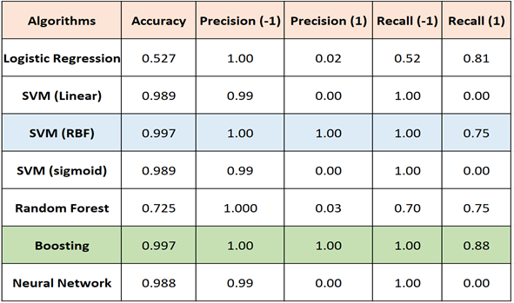
Predictive Modeling for Crack
Best

Slide 4
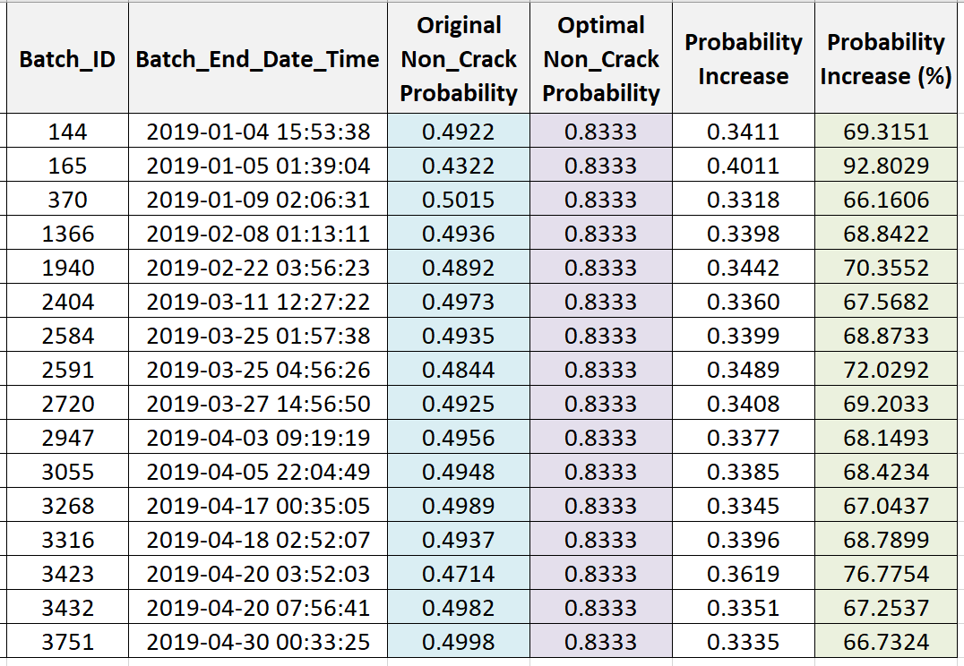
Prescriptive Recommendation for Crack:
Significant increase!

